Slide 1

Ideation and Evaluation of Business Ideas
UNIT-II

Slide 2
Unit II: Ideation and Evaluation of Business Ideas
Opportunity identification – Ideations process - Sources of business ideas – Role of creativity – Sources of Innovation –Technological Innovation and Entrepreneurship -Business Idea Evaluation - Product/ Service design – Design Thinking – Customer.

Slide 3
Opportunity identification
Opportunity identification can be defined as the cognitive process or processes through which individuals conclude that they have identified an opportunity.
It is important to note that opportunity identification is only the initial step in a continuing process, and is distinct both from detailed evaluation of the feasibility and potential.
It is a perceived means of generating incomes that previously have not been exploited and are not currently being exploited by others.

Slide 4

Apple Air Tag Tracker
The Air Tag Tracker can help customers find any device or item with visual and haptic guidance. It’s easy to set up and utilizes Apple’s My Find Networks millions of devices to locate an item.

Slide 5

Bluetooth speaker is perfect for those who sing in the shower. Shower Power is made from recycled ocean plastic, and it is also hydro powered using a hydroelectric generator. Because of this, it offers endless hours of music listening in the shower. Plus, it can even store up to 20 hours of power for use after the shower is over. Its ecologic design and engineering new products of the year.
Ampere’s Shower Power

Slide 6
Major factors affecting the process of opportunity Identification
Entrepreneurial alertness
Prior knowledge
Discovery versus purposeful search
Social networks
Personality traits, including risk-taking, optimism and self efficacy, and creativity.

Slide 7

Entrepreneurial alertness.
‘‘A tendency to notice and be sensitive to information about objects, incidents, and patterns of behavior in the environment, with special sensitivity to maker and user problems, unmet needs and interests, and novel combinations of resources.’

Slide 8
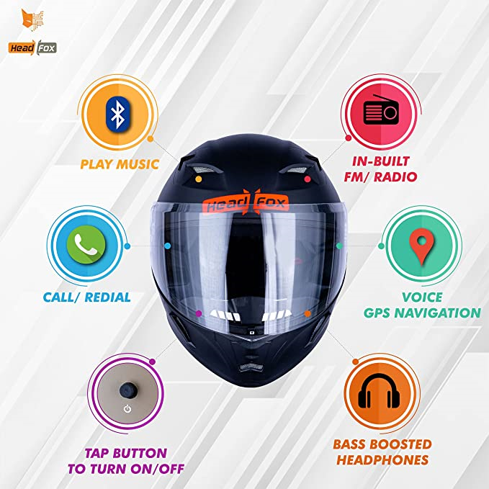
HEADFOX R1T Smart Bluetooth N1 Motorbike Helmet (RAPTOR-580MM
Price: ₹2,395.00

Slide 9
Prior knowledge
Entrepreneurs will discover opportunities because prior knowledge triggers recognition of the value of the new information.
Three major dimensions of prior knowledge are important to the process of entrepreneurial discovery:
prior knowledge of markets
prior knowledge of ways to serve markets
prior knowledge of customer problems.

Slide 10
Discovery versus purposeful search
Entrepreneurship implicitly assumed that recognition of opportunity is preceded by a systematic search for available opportunities.
Distinguishes discovery from successful search is that the former involves the surprise that accompanies the realization that one had overlooked something in fact readily available.’

Slide 11
Social networks
a sociocognitive framework of opportunity recognition. The framework shows that entrepreneurs evolve opportunities by pursuing three cognitive activities.
Information gathering
Thinking through talking
Resource assessing
through active interaction with an extensive network of people.

Slide 12
Personality traits
Entrepreneurial optimism is related to self-efficacy beliefs. It is important to point out that optimism about one’s ability to achieve specific, difficult goals (self-efficacy).

Slide 13
Entrepreneurship Opportunity Identification Process
Most entrepreneurs searching for new business ideas fundamentally consider three central issues. The main one is the potential economic value.
First considers if the venture has the capacity to generate profit.
Second is the newness of such a venture. Prefer products, services or technology that does not previously exist in that environment.
Third is the perceived desirability whether their product has the moral or legal acceptability in that environment.

Slide 14
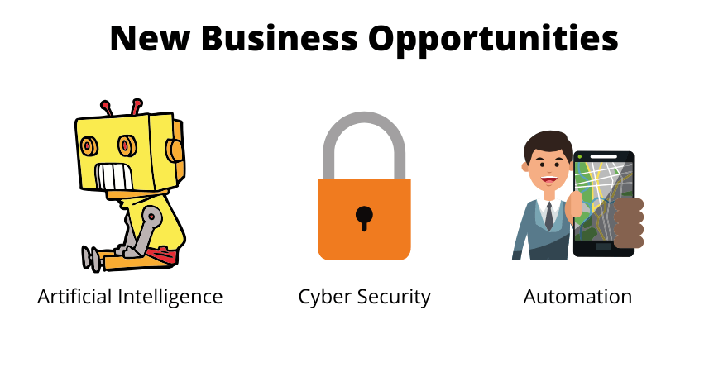

Slide 15
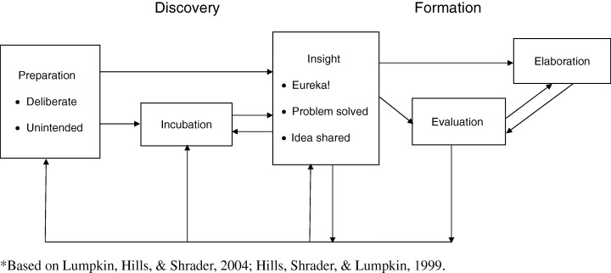
Entrepreneurship Opportunity Identification Process

Slide 16
Stages of Opportunity Identification Process
Preparation
Incubation
Insight
Evaluation
Elaboration

Slide 17


Slide 18
Preparation
Preparation stage is that knowledge and experience exercised just before the opportunity discovery process.
These knowledge and experience are not often deliberately acquired. However, preparation itself is usually a deliberate attempt to widen capability in an area and become sensitive to concerns in a field of interest.
In an organized situation, the background of the business, the products or services or the technological knowledge must have majorly informed the main ideas of the successful venture.

Slide 19

Incubation
Incubation means aid to develop an idea.
Incubator support emerging businesses with several services, such as assistance in building management teams, developing business and marketing plans, funds, professional services, shared equipment and more.

Slide 20
Insight
Developing the customer value proposition, developing the business model, developing financial models and capital raising..
It is a particular moment that keeps occurring persistently right through the process of opportunity identification.

Slide 21
Evaluation
Evaluation stage is about investigating if the recognized and developed ideas are feasible, if the businessman has the required abilities to realize the ideas and if the idea is sufficiently innovative for prospects.
Entrepreneurship is essentially the act of creation requiring the ability to recognize an opportunity, shape a goal, and take advantage of a situation. Entrepreneurs plan, persuade, raise resources, and give birth to new ventures.

Slide 22
Elaboration
Elaboration is that stage that exposes the opportunity/ideas to external analysis with the tedious and time–consuming options selection, choice decision and organization of resources.
It is customarily in search of all legalities that could build confidence and guarantee the practicability of the business.
Reduces uncertainties by providing the detailed planning activities after the evaluation viability confirmation. This will eventually reveal the concept areas that still need further analysis and attention.

Slide 23

Sources of business ideas

Slide 24

Sources of business ideas
1. Past Work Experience
2. Hobbies and Interests
3. Consultation
4. Customer surveys
5. Brainstorming
6. Travel
7. Books and Magazines
8. Current Trends
9. Research Organizations
10. The Web
11. Distribution Channels

Slide 25

1. Past work experience
Past work experience, especially business experience, will help you navigate all odds while thinking about your next business idea.
Past work experience is one of the greatest sources of business ideas as the entrepreneur already has the basic knowledge of the product he is planning to introduce to the market.
This experience helps you understand the customers' needs and how to build products that customers will appreciate.

Slide 26

2. Hobbies and interests
A hobby is an activity that you enjoy doing during your leisure time and is one of the primary sources of business ideas for entrepreneurs.
most people have founded great successful businesses while pursuing their interests or hobbies.
if you enjoy travelling, playing with computers, music, sports, performing or cooking, you can seamlessly develop it into a business.

Slide 27

3. Consultation
Consultation is defined as meeting with an expert in order to seek advice. You can consult with an expert in the business world on the best business ideas.
seeking professional advice will help you know what to expect, what goals to set, how and when to achieve them.
Consultants may also warn you about what is not working in the business world, which will help you make an informed decision on how to go about your business idea

Slide 28

4. Customer surveys
Customers are the largest source of new product ideas as they are the direct consumers of the products you plan on introducing to the market.
Opening up a business that will improve the current products to customers' tastes and preferences will help you navigate quickly through the business world.
You can also make contacts with prospective consumers who will help you know what needs to be improved on the current product.

Slide 29


Top Market Research companies
IMRB International (Indian Market Research Bureau) -1971
A name that always tops the list - IMRB International has its corporate office in the most happening city of India - Mumbai.
RNB Research( Rhythm and Blues) -1995
With its corporate office in New Delhi, India, RNB Research, which was established in the year 1995, is an ISO 9001:2000 certified marketing research as well as data collection company that exists in countries like South Africa, Thailand, India, China, Philippines and Russia. It is said to be one of the top five marketing research companies in India.

Slide 30

5. Brainstorming
Brainstorming is also one way of generating new business ideas.
Your thoughts are so powerful that they may have the power of generating a new product that has never been invented.
It is possible to develop your business idea and then convert it into a business that will become successful in the future. Brainstorming allows you to think freely without fear of getting judged.

Slide 31
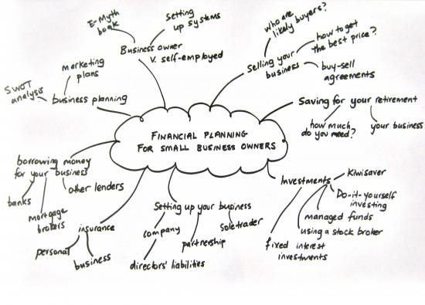

Slide 32

6. Market gap analysis
Necessity has always been the mother of invention. Market gap analysis provides an opportunity for the entrepreneur to know the existing gaps in the market and plan how to fill these gaps.
A gap analysis will also help the entrepreneur recognize the current state of products in the market by measuring time, money and labour and comparing it to his/her target.
You can identify a gap in the market by monitoring the trends in your area of expertise and keeping in touch with those in your industry

Slide 33

7. Research and development
An entrepreneur can also conduct research on the products that are available in the market and which ones have the highest demand.
There are so many areas where the entrepreneur can get such ideas, including but not limited to the internet, books and journals, research institutions etc.

Slide 34

8. Family and friends
Family and friends are also a great way of coming up with a business idea.
Could family and friends be the reason why there exist great family businesses that have thrived for centuries. There are plenty of businesses that you can venture into with your family or friends.

Slide 35

9. Current trends
Most people like being up to date with the latest trends in fashion, electronics and many other things.
Build up your business idea based on current trends to keep up with people's needs. Most people die for the latest phones; Watch out for the latest trends that people would die to have and offer them reasonable prices.
Current trends greatly inspire new business ideas.

Slide 36

10. Mass media
The mass media, including television, newspapers, the internet, radio, and magazines, are a great source of ideas, information, and opportunities.
One way to become a successful entrepreneur is taking a careful look at the advertisements and commercials in these media.
By reading a magazine or newspaper, you can easily come across a business for sale that interests you. The media can also report on the trending fashion and pressing customer needs that you can jump on and start a business.

Slide 37

11.Distribution Channels:
The retailers and the distributors are the people closest to the consumer. No one knows more than them, what the consumer wants and what is he/she getting right now. Most distributors deal with a wide variety of products so their experience may be across industries.

Slide 38

ROLE OF CREATIVITY

Slide 39

Introduction
Creativity is the single variable or ability to develop something original, particularly an idea or a representation of an idea.
Entrepreneurs show creativity in problem-solving processes. Creativity is often seen in both the writing and design domain.

Slide 40
Components of creativity
Fluency – Speed of response to a problem
Flexibility – Spontaneous flexibility for problem solving
Originality – Solution is both novel and useful (Infrequent but Appropriate)
Elaboration – step by step idea implementation
Sensitivity to problem – identify the gaps in the problem
Ability to redefine problem – define a problem in clearest and simplest form.

Slide 41
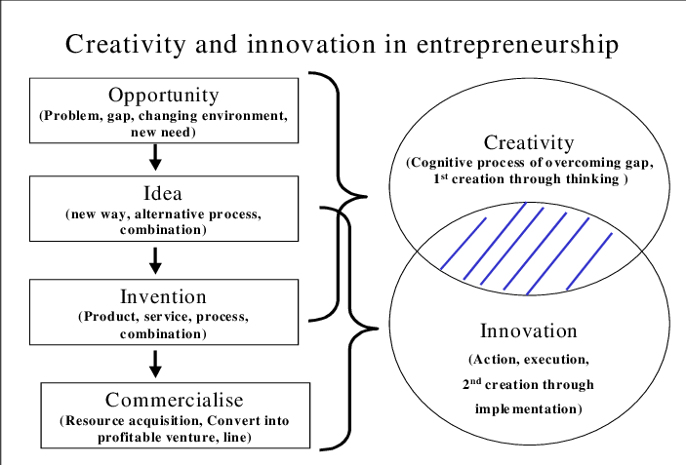

Slide 42
Importance of Creativity in Entrepreneurship
To Face Cut-Throat Competition
Entry of New Products in Market
Best Communication
Forecast of Changes
Integration with Firm
Establishment of Cordial Relations
Success in Reducing Cost of Labour and Production
Increasing Power to Make Organisation Capable
Search of New Opportunities Becomes Possible
Success of Employees
Settlement of Disputes

Slide 43
THE ROLE OF CREATIVITY IN ENTREPRENEURSHIP

Slide 44
The role of creativity in entrepreneurship
High overall success
Increase productivity
Exploit employee potential
Transcend boundaries
Encourage critical thinking
Foster innovation

Slide 45

Encourage critical thinking
Problem-solving works best when coupled with highly disciplined and focused thinking. Entrepreneurs can think in convergent thinking mode.
Convergent thinking involves in-depth analysis and enables an entrepreneur to find the most feasible solution to a managerial or financial problem.
It allows entrepreneurs to use various data sources such as accounting software and computer systems.

Slide 46

Foster innovation
Manufacturers create unique products to not only meet customer expectations but exceed them as well.
While it may be hard to spot this from the beginning, things start to get more evident as your idea turns into a reality.
In fact, this is the time an entrepreneur begins to realize how innovation and invention differ. The invention refers to a new, unique concept while innovation is an idea which is as unique and useful as the original one.

Slide 47
Process of Creativity
Phases:
Back ground or Knowledge accumulation
The Incubation Process
The Idea experience
Evaluation and Implementation

Slide 48
Phase 1: Background or knowledge accumulation
Successful creations are generally preceded by investigation and information gathering.
This usually involves extensive reading, conversations with others working in the field, attendance at professional meetings and workshops and a general absorption of information relative to the problem or issue under study.
Additional investigation in both related and unrelated fields is sometimes involved.

Slide 49
Phase 2: The mind incubation process
Creative individuals allow their subconscious to consider over the tremendous amounts of information they gather during the preparation phase.
This incubation process often occurs while they are engaged in activities totally related to the subject or problem. It happens even when they are sleeping. This accounts for the advice frequently given to a person who is frustrated by what appears to be an unsolvable problem.

Slide 50

Phase 3: The idea experience
This phase of the creative process is often the most exciting. It is when the idea or solution the individual is seeking is discovered. Sometimes referred to as the eureka factor, this phase is also the one the average person incorrectly perceives as the only component of creativity.

Slide 51
Phase 4: Evaluation and implementation
This is the most difficult step of a creative endeavor and requires a great deal of courage, self-discipline and perseverance.
Successful entrepreneurs can identify ideas that are workable and that they have the skills to implement.
More important, they do not give up when they run into temporary obstacles. Often they will fail several times before they successfully develop their best ideas.

Slide 52

Sources of Innovation

Slide 53

Sources of Innovation
Potential entrepreneurs must always be alert to the opportunities that lie in the external and internal environments in which they live.
Trends
Unexpected Occurrences
Incongruities
Process Needs
Industry and Market Changes
Demographic Changes
Changes in Perception
New Knowledge

Slide 54
Changes in Perception
Perceptual changes: These changes occur in people’s interpretation of facts and concepts. They are intangible yet meaningful. Perception can cause major shifts in ideas to take place.
Another example is people’s desire to better use their personal time. As a result, the travel industry has capitalised on the consumers’ current need to see the world while they are young and healthy.

Slide 55
Types of innovation
Four basic types of innovation exist These extend from the totally new to modifications of existing products or services. In order of originality the four types are:
Invention – the creation of a new product, service, or process, often one that is novel or untried; such concepts tend to be revolutionary
Extension – the expansion of a product, service, or process already in existence; such concepts make a different application of a current idea
Duplication – the replication of an already existing product, service, or process; the duplication effort, however, is not simply copying but adding the entrepreneur’s own creative touch to enhance or improve the concept to beat the competition.
Synthesis – the combination of existing concepts and factors into a new formulation; this involves taking ideas or items already invented and finding a way so together they form a new application.

Slide 56
Principles of innovation
Potential entrepreneurs need to realise innovation principles exist. These principles can be learned and, when combined with opportunity, can enable individuals to innovate. The major motivation principles follow:
• Be action oriented: Innovators always must be active and searching for new ideas, opportunities, or sources of innovation.
• Make the product, process, or service simple and understandable: People must readily understand how the innovation works.

Slide 57
Make the product, process, or service customer-based: Innovators always must keep the customer in mind. The more an innovator has the end-user in mind, the greater the chance the concept will be accepted and used.
•Start small: Innovators should not attempt a project or development on a grandiose scale. They should begin small and then build and develop, allowing for planned growth and proper expansion in the right manner and at the right time.

Slide 58
Aim high: Innovators should aim high for success by seeking a niche in the marketplace.
• Try/test/revise: Innovators always should follow the rule of try, test and revise. This helps work out any flaws in the product, process, or service.
• Learn from failures: Innovation does not guarantee success. More important, failures often give rise to innovations.

Slide 59

Follow a milestone schedule: Every innovator should follow a schedule that indicates milestone accomplishments. Although the project may run ahead or behind schedule, it is still important to have the schedule in order to plan and evaluate the project.
• Reward heroic activity: This principle applies more to those involved in seeking and motivating others to innovate. Innovative activity should be rewarded and given the proper amount of respect.

Slide 60

Technological Innovation and Entrepreneurship

Slide 61
Technological Innovation
Technological innovation is the process where an organization (or a group of people working outside a structured organization) embarks on a journey where the importance of technology as a source of innovation has been identified for increased market competitiveness.
"Technological innovation" better reflects the business consideration of improving business value by working on the product or services' technological aspects.

Slide 62
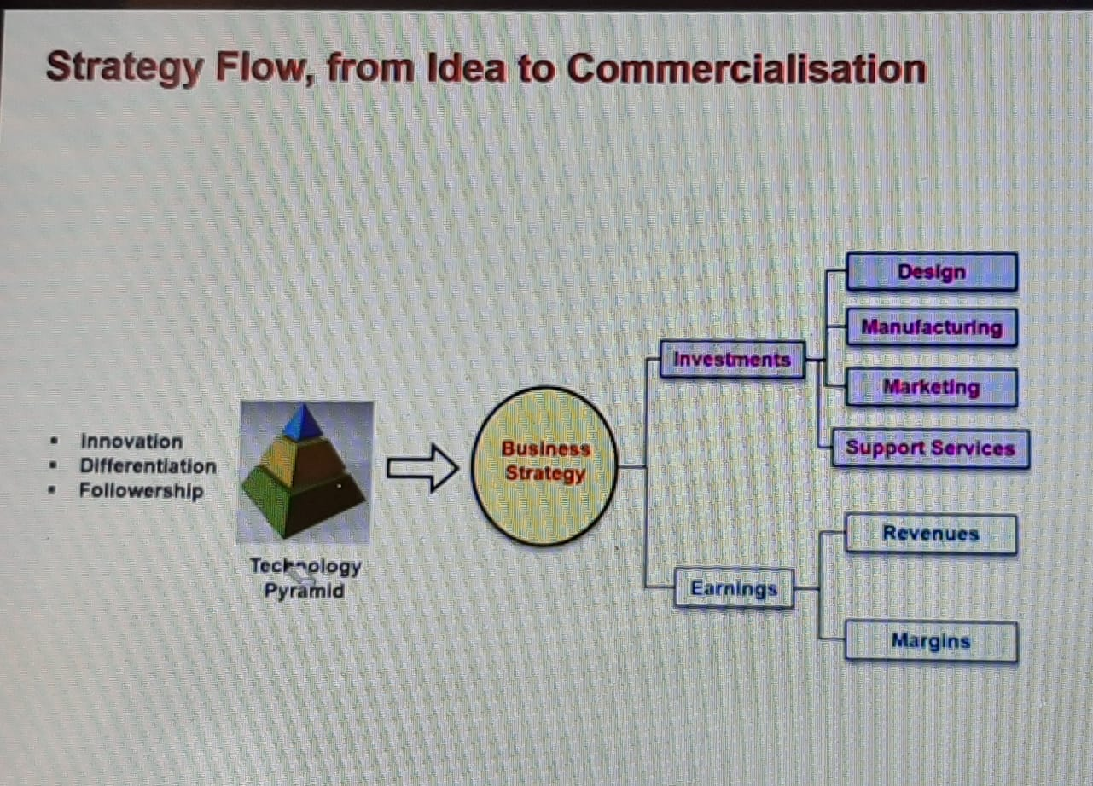

Slide 63
LATEST TECHNOLOGIES
5G networks
Block chain apps
AI-enabled platforms for automated work
Machine learning for customer service
3D printing
New security measures
Augmented reality
Wearable tech

Slide 64
Product/ Service design

Slide 65
Product/ Service design
Need of Product and Service design
Translate customer wants and needs into product and service requirements. (marketing, operations)
Refine existing products and services. (marketing)
Develop new products and/or services. (marketing, operations)
Formulate quality goals. (marketing, operations)
Formulate cost targets. (accounting, finance, operations)
Construct and test prototypes. (operations, marketing, engineering)

Slide 66
Factors influence on Product and Service Design
Economic
(e.g., low demand, excessive warranty claims, the need to reduce costs).
Social and demographic
(e.g., aging baby boomers, population shifts).
Political, liability, or legal
(e.g., government changes, safety issues, new regulations).
Competitive
(e.g., new or changed products or services, new advertising/promotions).
Cost or availability
(e.g., of raw materials, components, labor).
Technological
(e.g., in product components, processes).

Slide 67
Phases in Product Design and Development
Idea generation
Feasibility analysis
Product specifications
Process specifications
Prototype development
Design review
Market test
Product introduction
Follow-up evaluation.

Slide 68

Design Thinking

Slide 69
Design Thinking
Design Thinking is a design methodology that provides a solution-based approach to solving problems. It’s extremely useful in tackling complex problems that are ill-defined or unknown, by understanding the human needs involved.

Slide 70
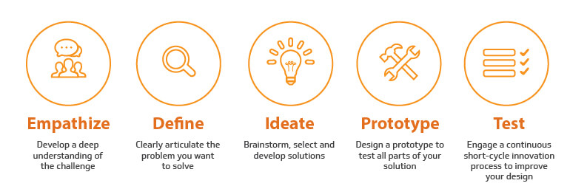
Design Thinking process

Slide 71
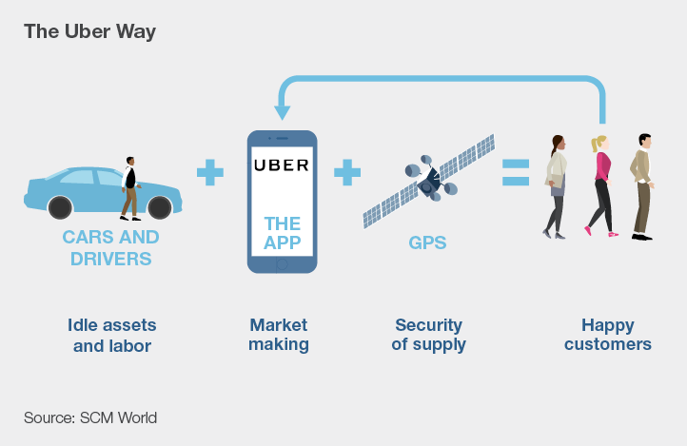

Slide 72


Slide 73
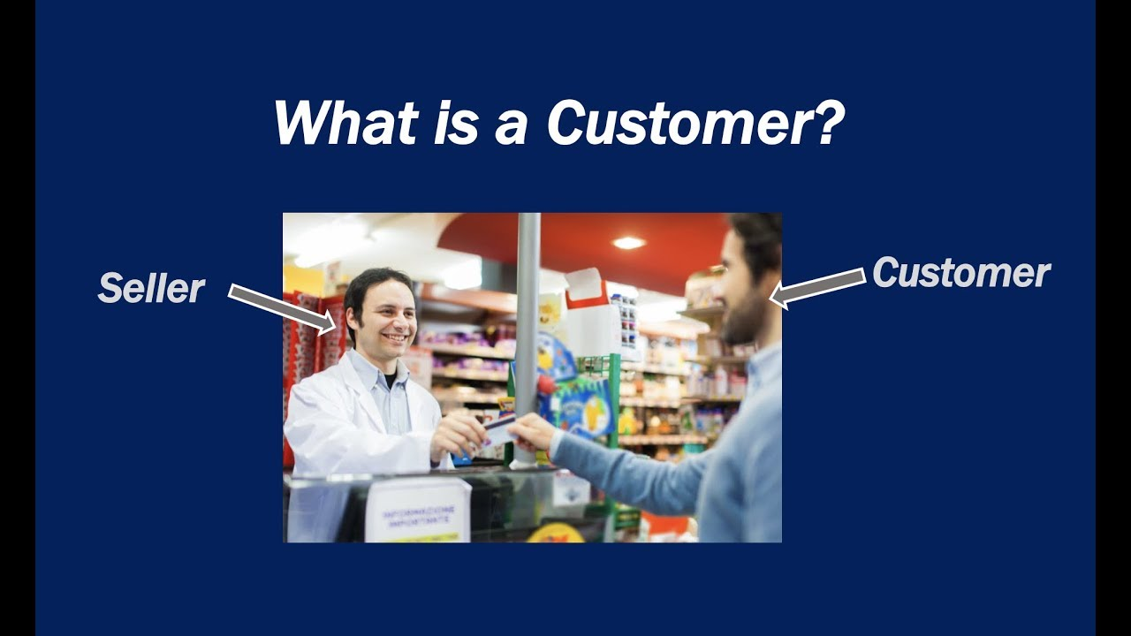

Customer
A customer is any person or organization who might have interest in buying, or has bought, products or services from a company. Each time you pay a bill or buy something from a store you are acting as their customer.
In general, there are three basic types of customers.
Current customers
Past customers
Potential customers
Each customer type influences a company differently.

Slide 74
